Slide 1
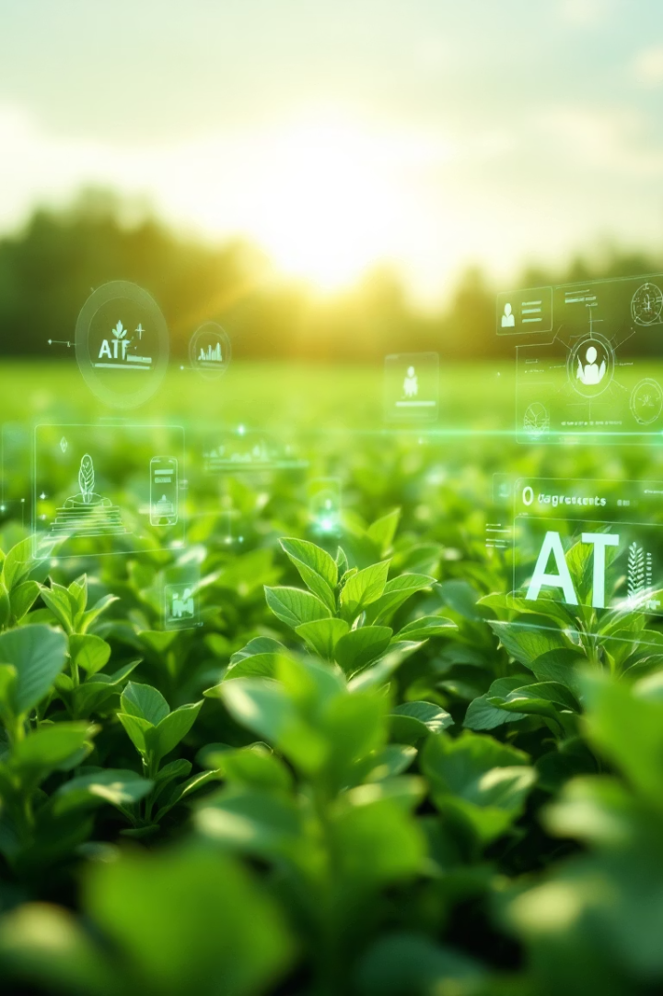
ByteForce Crop Disease Detection System
AI-powered plant disease identification and treatment solution for sustainable farming.

Slide 2
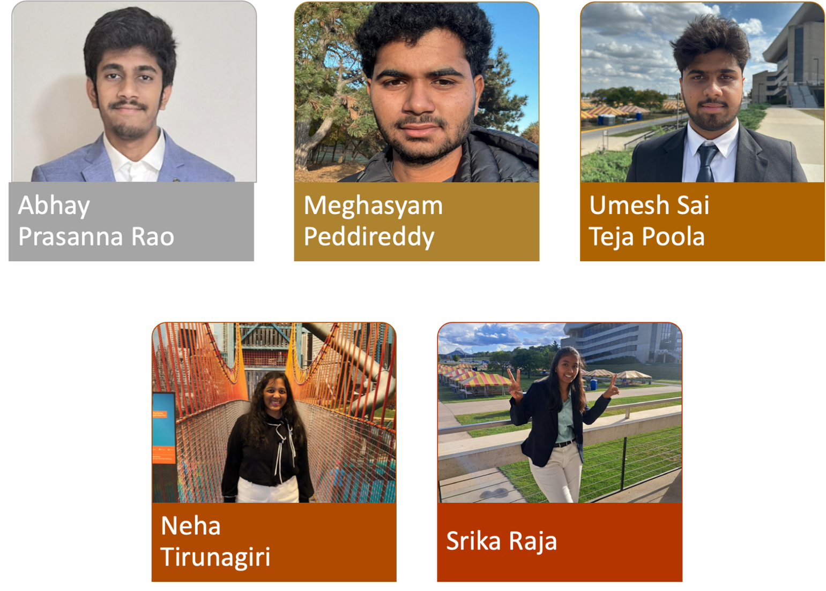
OUR
TEAM
Notes:
We’re a diverse team focused on solving real agricultural problems.
Team members: Meghasyam, Umesh, Neha, Srika, and myself.
Combined expertise in ML, agricultural science, and software.
Each person contributed unique skills to shape this solution.
Our shared mission: help Iowa farmers detect and treat diseases early.

Slide 3
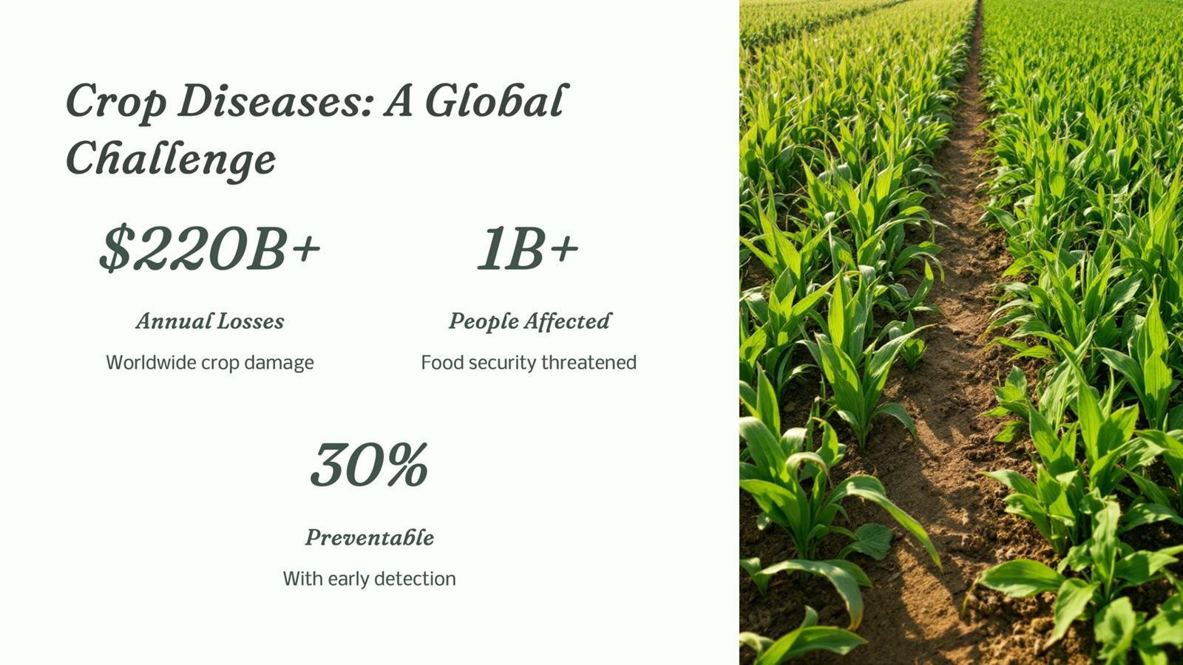

Slide 4
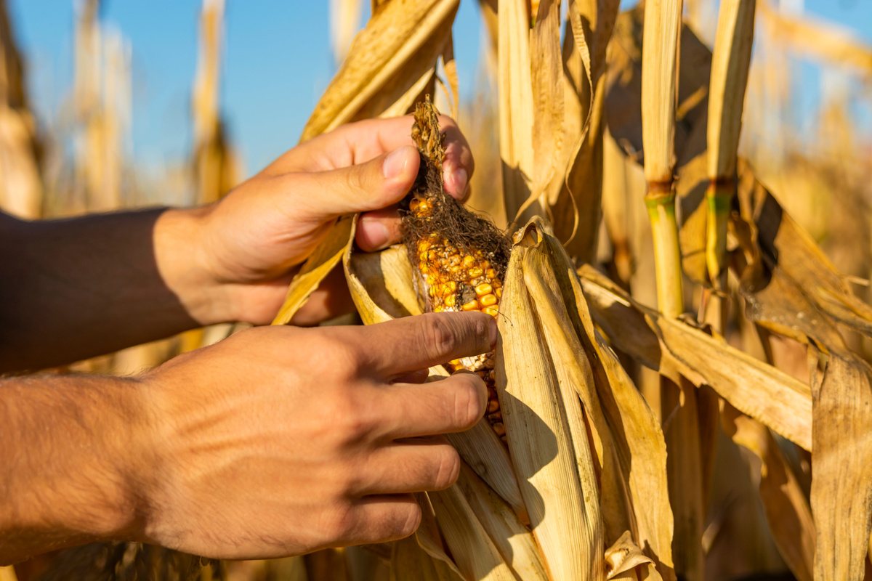

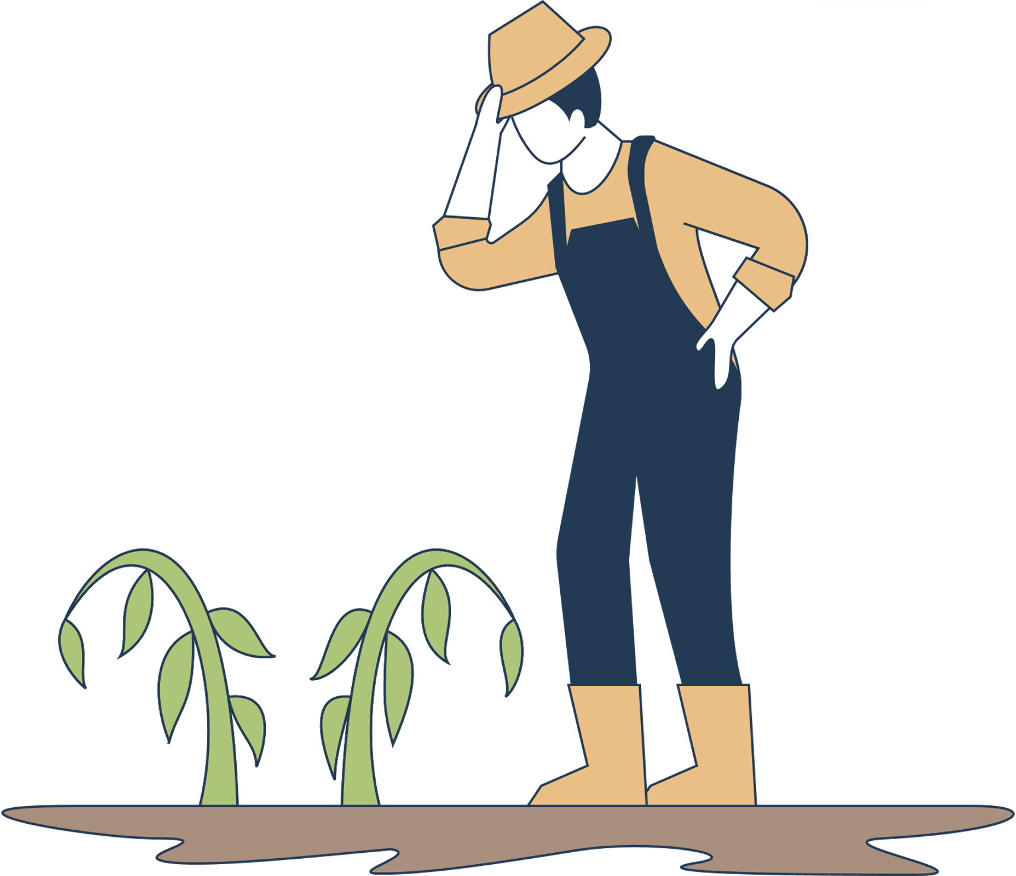
Current Process
Visual Inspection
Guesswork / Experience-Based Diagnosis
Extension Office or Lab Testing
Farmers walk through fields, manually checking leaves for discoloration, spots, wilting, or insect damage.
Rely on personal experience or consult with neighboring farmers or agronomists to diagnose the issue
In some cases, leaves are collected and sent to local university labs or ag extension services for testing, with a 3-7 day turnaround time.

Slide 5
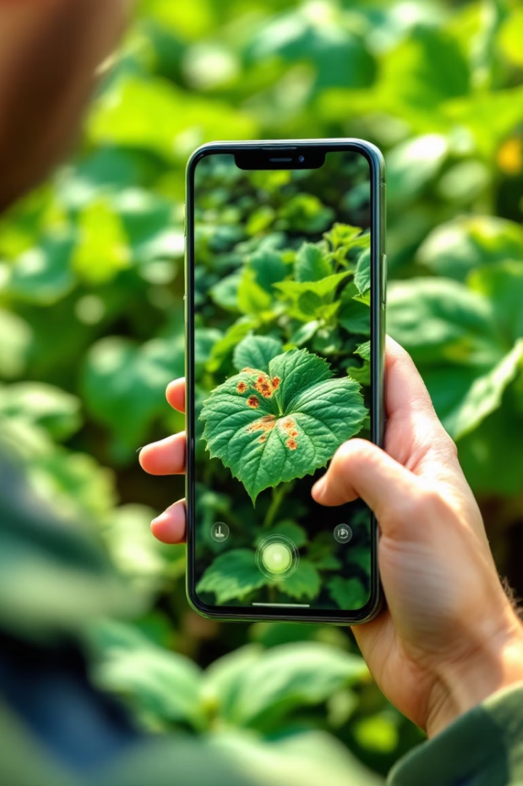




Our Solution
AI-powered analysis
Instant disease identification
Specialized detection
Iowa Specific crops
Weather integration
Optimal treatment timing
Sustainable practices
Long-term crop health
Notes:
5

Slide 6
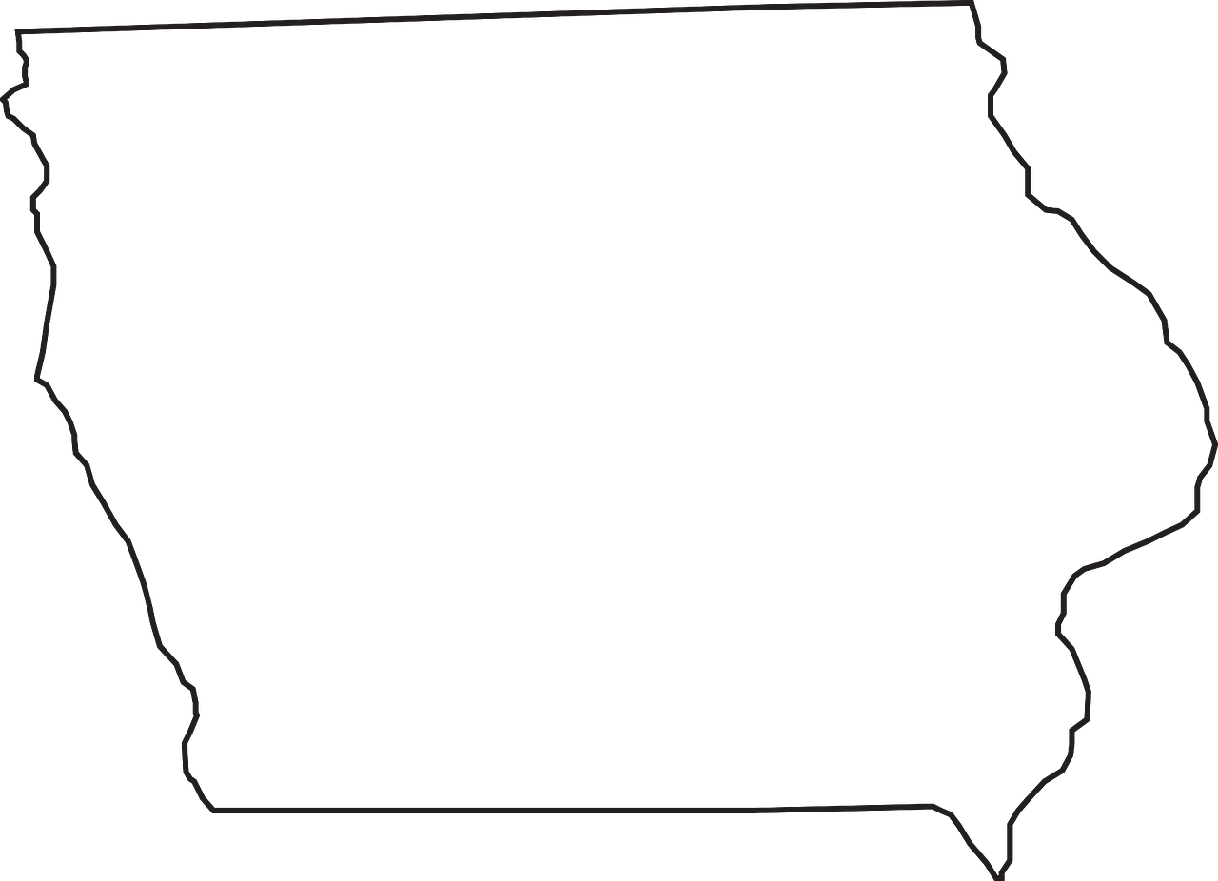


What Makes Us Unique?
Localized to Iowa & Midwest
Tailored to the crop types, and common diseases in Iowa and surrounding Midwest regions, unlike one-size-fits-all solutions.
Integrated Weather-Aware Recommendations
Provides weather-informed treatment schedules, enhancing the timing and effectiveness of interventions.
Notes:
7

Slide 7
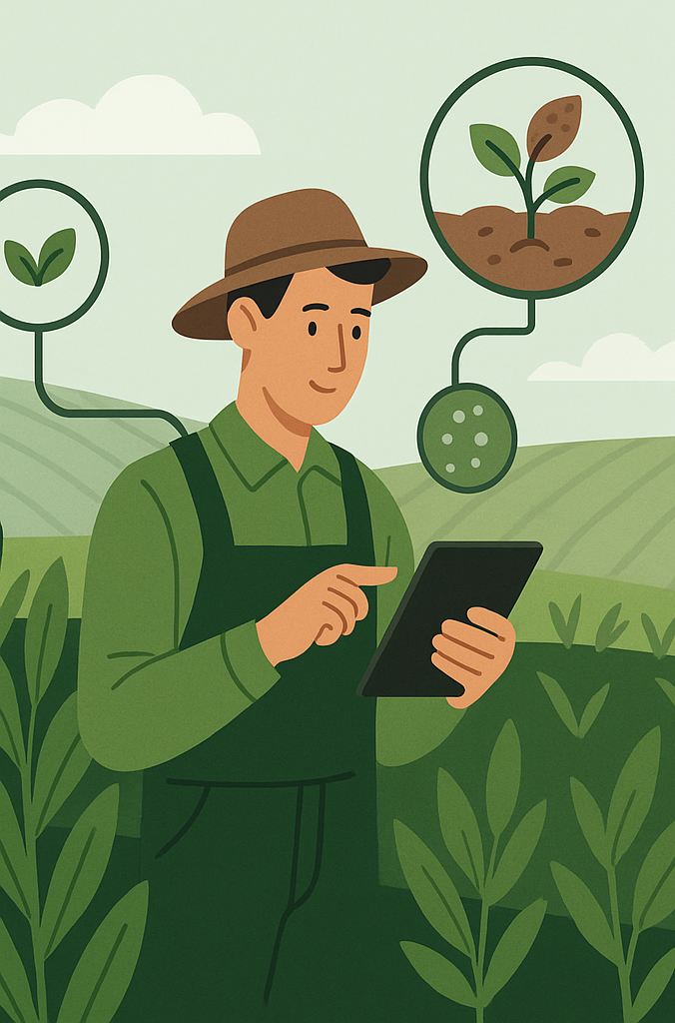




Impact
Time Savings
Reduces manual disease time by over 70%
Cost Efficiency
Reduces unnecessary pesticide usage and crop health consulting fee
Yield Protection
Helps prevent up to 30% crop loss with early detection
Farmer Empowerment
Provides accessible diagnostics
Notes:
6

Slide 8


Datasets
Dataset
Brief Description
20K Dataset
20,000+ images of wheat, maize, cotton, sugarcane, and rice diseases from
Kaggle, web scraping, and field data.
New Plant Disease
87K images in 38 classes (healthy + diseased), based on PlantVillage with offline
augmentation.
Sorghum Disease
7167 images covering 5 sorghum diseases (e.g., Smuts, Rust), used for plant
pathology and ML training.
Corn Leaf
4-class dataset (Common Rust, Gray Leaf Spot, Blight, Healthy), curated from
Plant Village + PlantDoc.
Soybean
Dataset of 7 soybean diseases + healthy, collected and shared via Kaggle.
Cassava
Images of 5 disease types affecting cassava, used in African agricultural disease
detection challenges.
Apple
Classifies leaves as Healthy, Rust, Scab, or multiple diseases; includes metadata
and image folders.
Tomato
Tomato disease dataset from PlantVillage, used widely for leaf disease detection
research.
Notes:
8

Slide 9
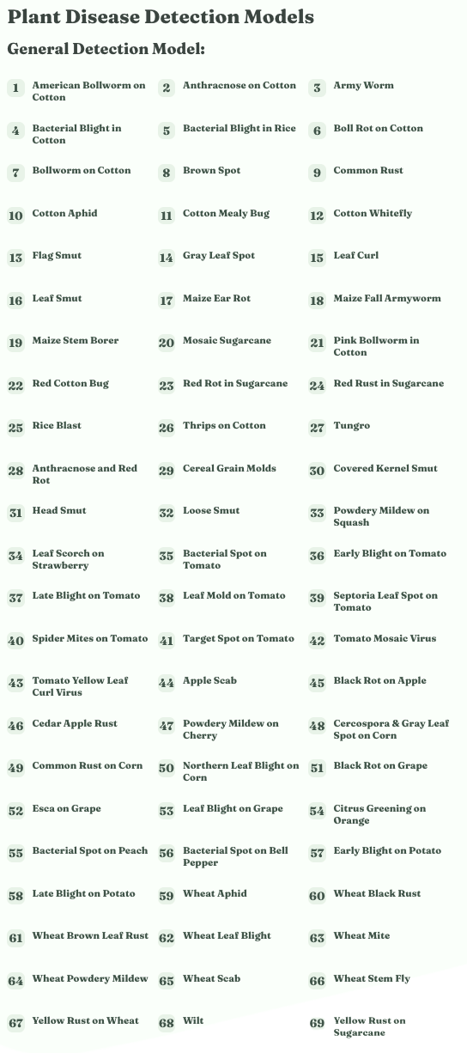
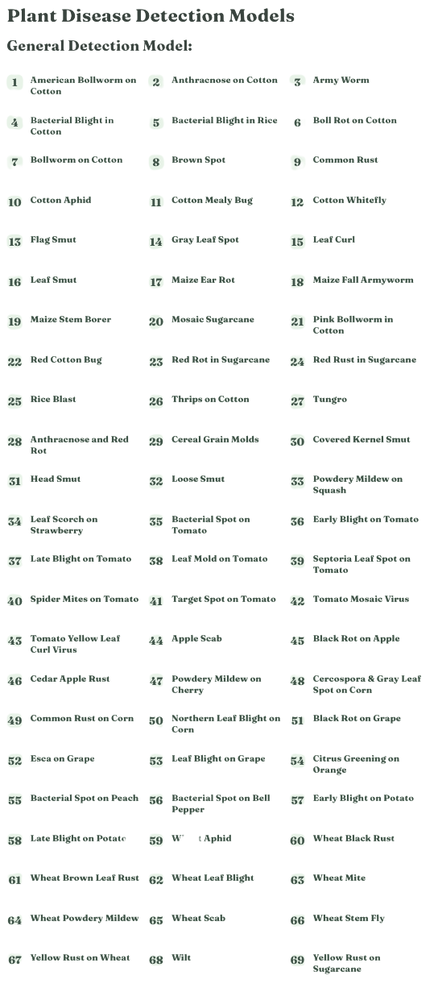


Slide 10
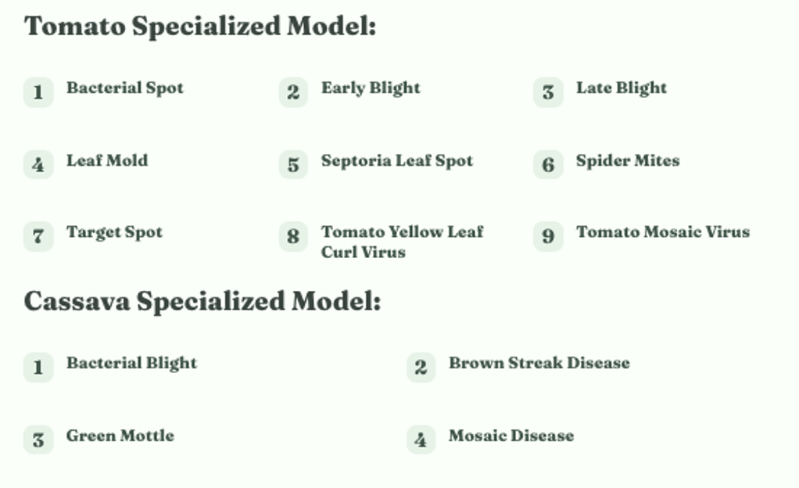
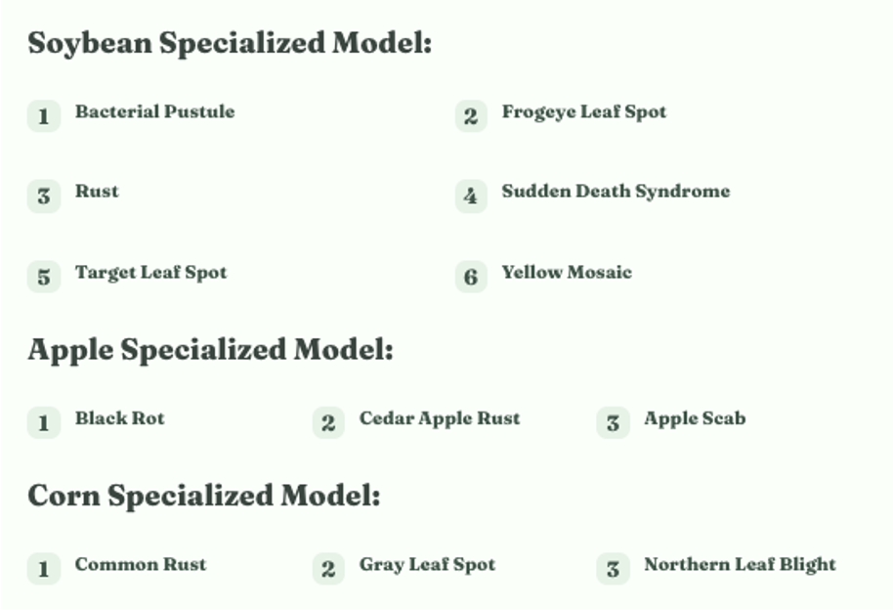

Slide 11
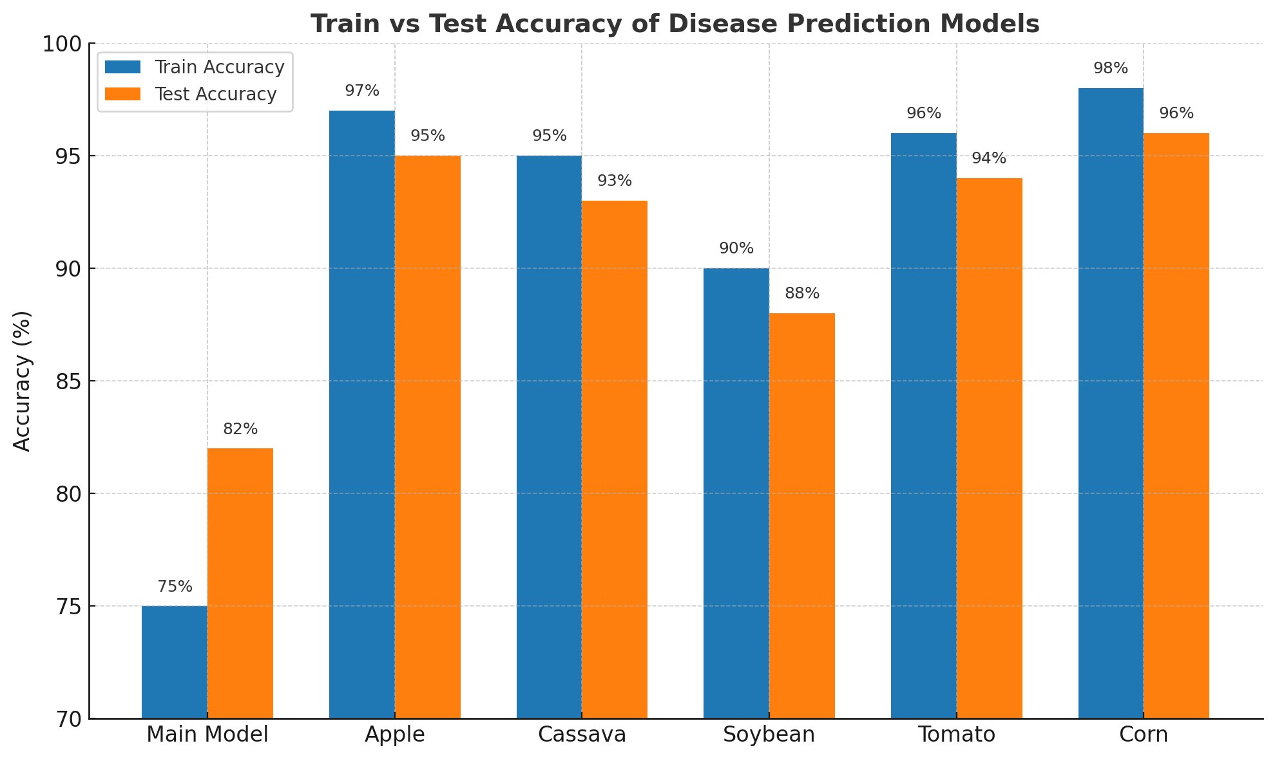

Slide 12
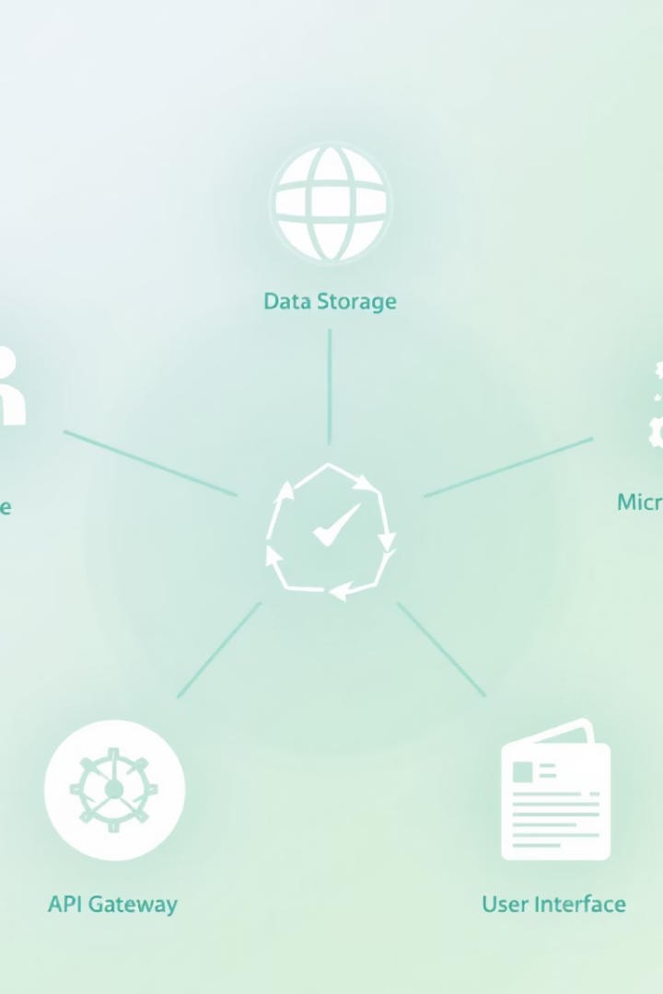




System Architecture
User Interface
React.js frontend
Backend
FastAPI services
ML Models
Deep learning ensemble
External APIs
Weather and plant data
Notes:
11

Slide 13
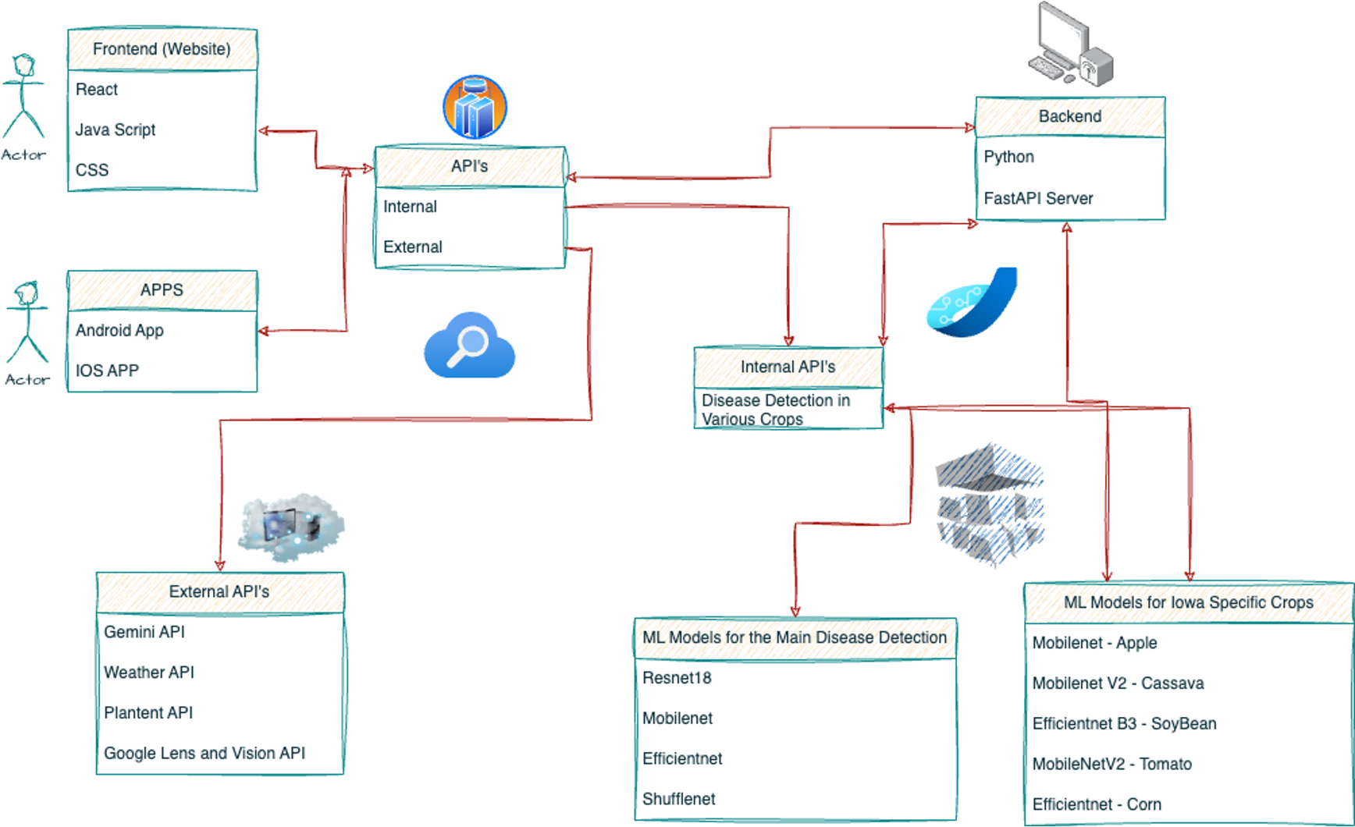
Notes:
12

Slide 14
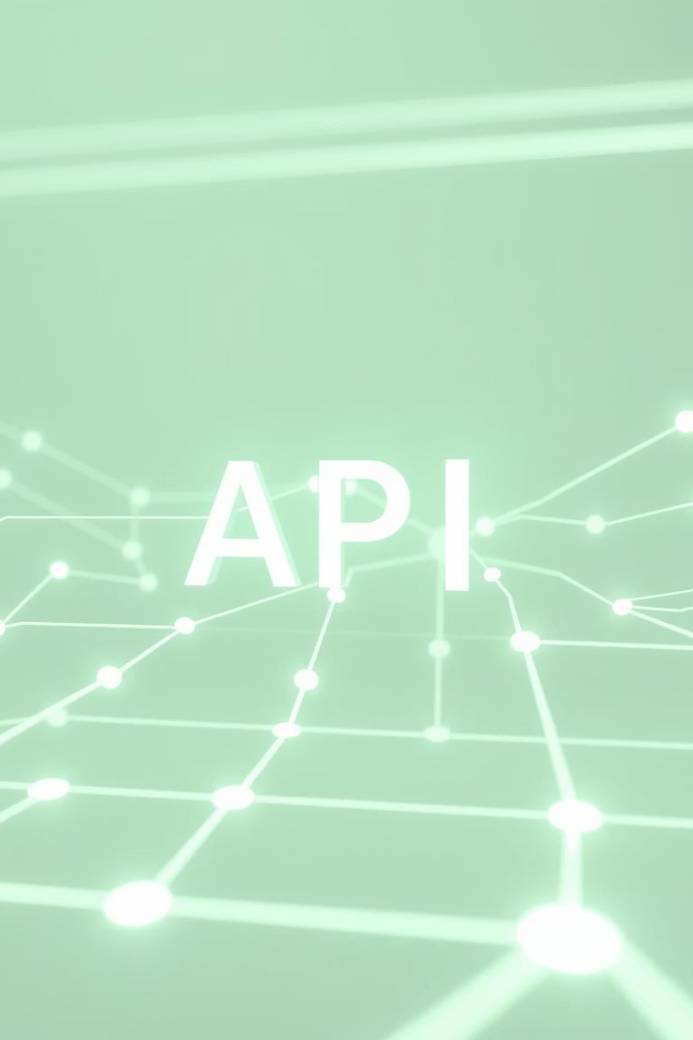






External Integrations
PlantNet API
Image-based plant identification
Weather Data
Real-time environmental conditions
Gemini API
Treatment recommendations
Notes:
13

Slide 15

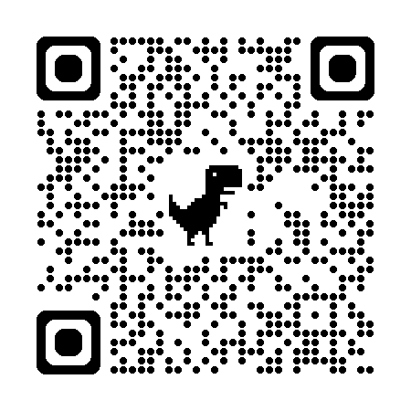



Getting Started
Clone repository
git clone from GitHub
Start backend
Install requirements and run api_server.py
Launch frontend
npm install and npm start
Access application
Visit localhost:3000
Notes:
14

Slide 16
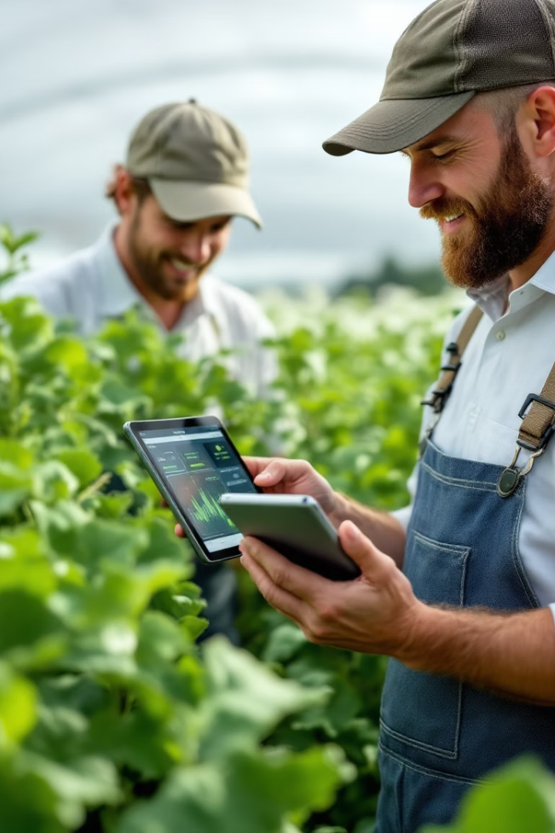
System Demo
Image Upload
Simple drag-drop interface
Disease Detection
Real-time analysis results
Treatment Plan
Customized recommendations
Analytics Review
Historical data insights
Notes:
15

Slide 17
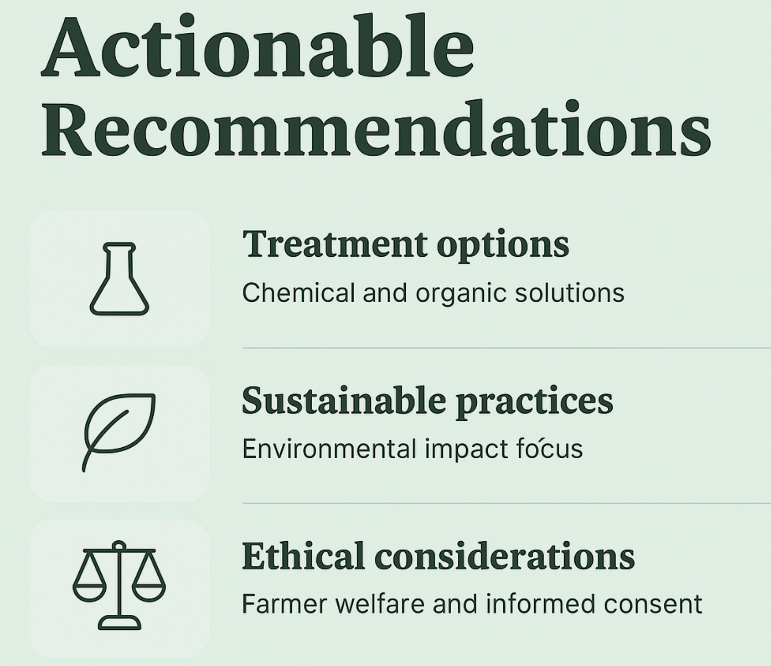
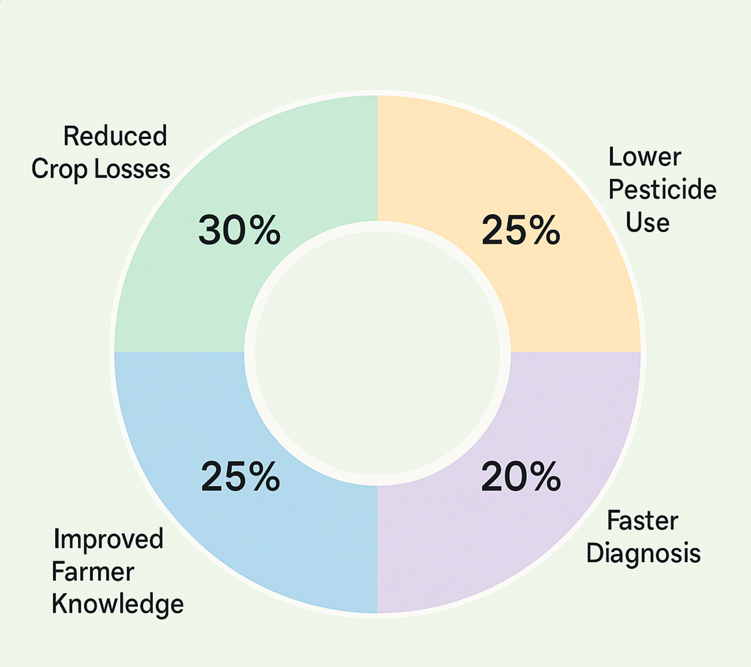
Expected Outcomes
Notes:
16

Slide 18
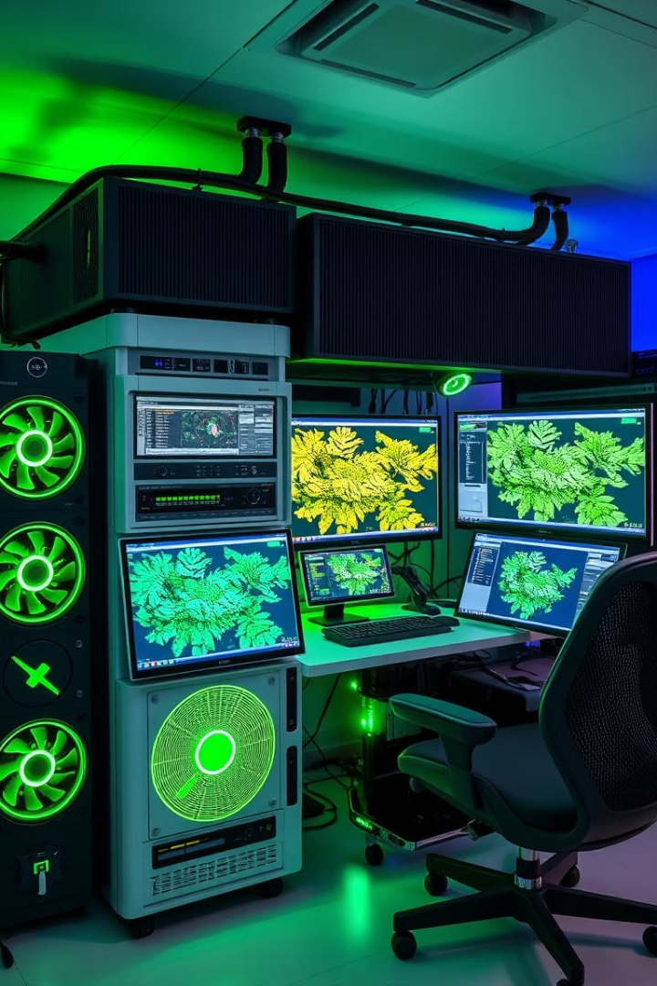




Computational Resources
GPU
RAM
Storage
CUDA-capable, 8+ GB VRAM
16+ GB for preprocessing
100k+ images for models to train on
Training Time
8-20 hours per model
Notes:
17

Slide 19




Current Limitations
Image Quality
Requires good-quality images.
Offline
No offline functionality for certain functionalities.
Accuracy
Lower Accuracy for general model.
Notes:
18

Slide 20




Future Roadmap
Mobile app version
On-the-go disease detection + Live Image Analysis
Expand crop database
Cover more crop varieties
Drone/sensor integration
Automated field monitoring
Local partnerships
Co-ops and ISU Extension
Notes:
19

Slide 21
Thank You
Together, let's empower sustainable agriculture with Al.
Your feedback, questions, and ideas are always welcome.
Notes:
19

